Slide 1

Training a Sentiment AI
A Notebook Walkthrough of a PyTorch Neural Network

Slide 2
The Objective
To build and train a model that can read raw text and output a continuous sentiment score from -1.0 (Negative) to +1.0 (Positive).

Slide 3
Step 1: The Data
Text (Input) | Label (Target)
"I love this product, it's perfect..." | 0.95
"This application is absolutely terrible..." | -0.90
"It works fine most of the time..." | 0.30
"I'm so disappointed with the constant bugs." | -0.85
"Okay I guess, nothing special about it..." | 0.00

Slide 4


The Core Challenge: Text vs. Numbers
Input: Raw Text
Required: Numerical Vector
A computer does not understand the *meaning* of the string "This is terrible."
A neural network only accepts numbers. We must convert the text into a meaningful vector.

Slide 5
Step 2: Feature Engineering (TF-IDF)
We use TF-IDF (Term Frequency-Inverse Document Frequency) to convert text into a vector.
Term Frequency (TF): How often a word appears in the message. (e.g., "bad" appears 1 time).
Inverse Document Frequency (IDF): Increases the score for words that are rare across *all* messages.
Result: Important, descriptive words like "furious" get a high score, while common words like "the" or "is" get a score near zero.

Slide 6
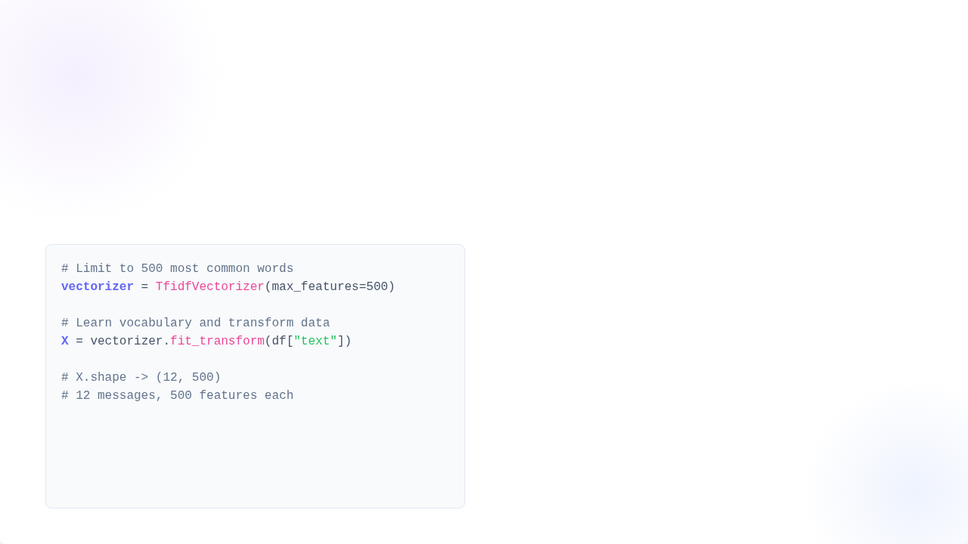
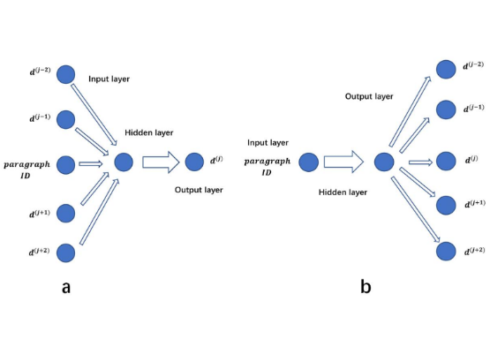
TF-IDF: From Code to Vector
Vectorization with Scikit-learn
We use `TfidfVectorizer` to learn the vocabulary and transform our text into a matrix.

Slide 7
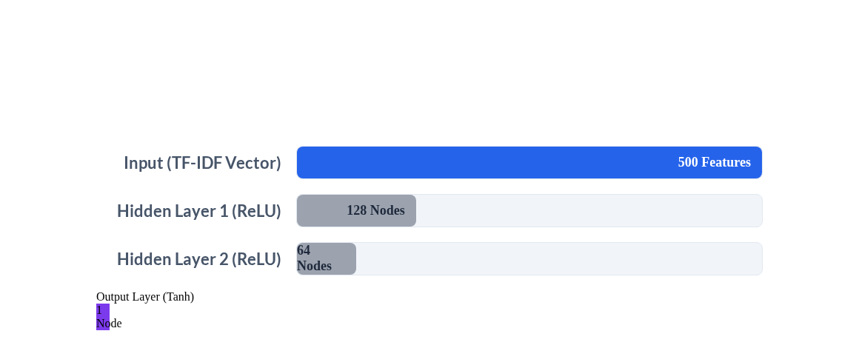
Step 3: Model Architecture (PyTorch)
Feedforward Neural Network (FNN)
The vector is fed into a stack of simple layers. The final Tanh activation squashes the output to our -1.0 to +1.0 range.

Slide 8
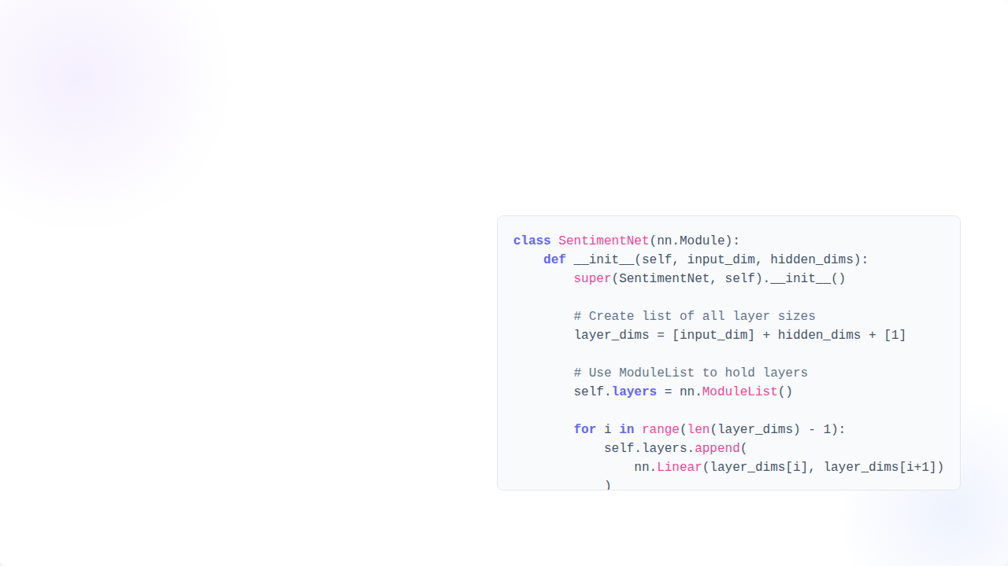
Architecture: A Dynamic Network
Flexible Layers with `nn.ModuleList`
The `SentimentNet` Code
The model isn't hard-coded. By using a `ModuleList`, the network can be instantly rebuilt with any number of hidden layers based on a simple list of numbers.
e.g., `[128, 64]` creates the model on the previous slide, while `[256, 128, 64, 32]` would create a deeper 4-layer network.

Slide 9






Step 4: Training Setup
Compute Device
Loss Function
Optimizer
We check for a GPU (`"cuda"`) to accelerate training. If not found, it defaults to `"cpu"`. All data and the model are moved to this device.
Mean Squared Error (MSELoss). This measures the average squared difference between the predicted score (e.g., 0.8) and the true label (e.g., 0.95).
Adam. This is the algorithm that "listens" to the Loss and adjusts all the network's weights to minimize the error on the next pass (epoch).

Slide 10
The Training Loop (In 5 Steps)
For each Epoch (one full pass over the data), the model repeats these five steps:
`optimizer.zero_grad()`: Reset all tracked changes from the last step.
`output = model(X_train)`: Make a prediction (Forward Pass).
`loss = criterion(output, y_train)`: Calculate how "wrong" the prediction was.
`loss.backward()`: Calculate the gradient (direction) of the error for every weight.
`optimizer.step()`: Update all weights in the network to reduce the error.

Slide 11
Step 5: Prediction Results
Testing the trained model on new, unseen text.
New Text (Input) | Predicted Score (Output) | Sentiment
"The agent was fantastic and solved my issue instantly! I'm delighted." | 0.96 | Positive
"This is broken and infuriating. My account is locked." | -0.88 | Negative
"I have no preference about the color of the application." | 0.02 | Neutral
"The service was bad and my issue wasn't fixed." | -0.79 | Negative

Slide 12
Questions?

Slide 13


Image Sources
https://www.mdpi.com/processes/processes-10-00350/article_deploy/html/images/processes-10-00350-g002.png
Source: www.mdpi.com

